Slide 1
Day 1
(ok, it’s really day 2)
Intro to Geospatial Tech
Notes:
Note: remember that this is IGME 382. Some folks take intro at the beginning, some the end, but it’s usually the end who will get the most benefit. Getting an introduction to things is good; however, courses like this typically are “tips and tricks” for advanced users and “this is what you could do” for new bees.

Slide 2
still the right place?
Notes:
Are you all in the right place? No judgement if you want to run away!

Slide 3


Nick LaLone njligm@rit.edu
Notes:
I’m still me. You can find a lot of stuff about me online. One thing to note: mistakes. I love making mistakes.

Slide 4
Nick LaLone njligm@rit.edu Office: 70-2519 (2nd floor, Golisano) Hours: 1-4p T/R
Notes:
So here is the pertinent information about me. My office is over in Golisano near Sean Boyle, Konstantine Papangelis, and Brian Tomazeuski. Come say hi sometime!

Slide 5
fundamentals!
Notes:
I thought we’d begin in a VERY basic way. Some of this stuff might seem like common sense or elementary, but we should make sure we have our bearings before we get going.

Slide 6
what is space?
Notes:
The most important thing to consider is this, what is space? How do we define it?

Slide 7
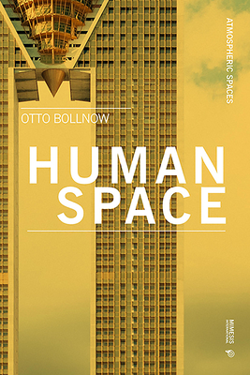


Slide 8
and so, … ?

Slide 9
What is GIS?
Notes:
information about places on the earth’s surface
knowledge about “what is where when”
Geographic/geospatial: synonymous

Slide 10
info about the earth
(do you believe this?)

Slide 11
where AND when
Notes:
information about places on the earth’s surface
knowledge about “what is where when”
Geographic/geospatial: synonymous

Slide 12
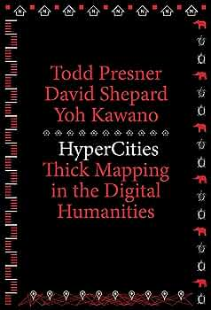
Notes:
information about places on the earth’s surface
knowledge about “what is where when”
Geographic/geospatial: synonymous

Slide 13
and so, … ?
Notes:
Geographic essentially means geographic space information or geospatial data.

Slide 14
system(s)?
science(s)?
study(ies)?
Notes:
GIS--what’s in the S?
Systems: the technology
Science: the concepts and theory
Studies: the societal context

Slide 15
but what info?
Notes:
Wait, I’ve never seen you before. Are you an adjuct? A student? What?

Slide 16
location!
Notes:
Wait, I’ve never seen you before. Are you an adjuct? A student? What?

Slide 17
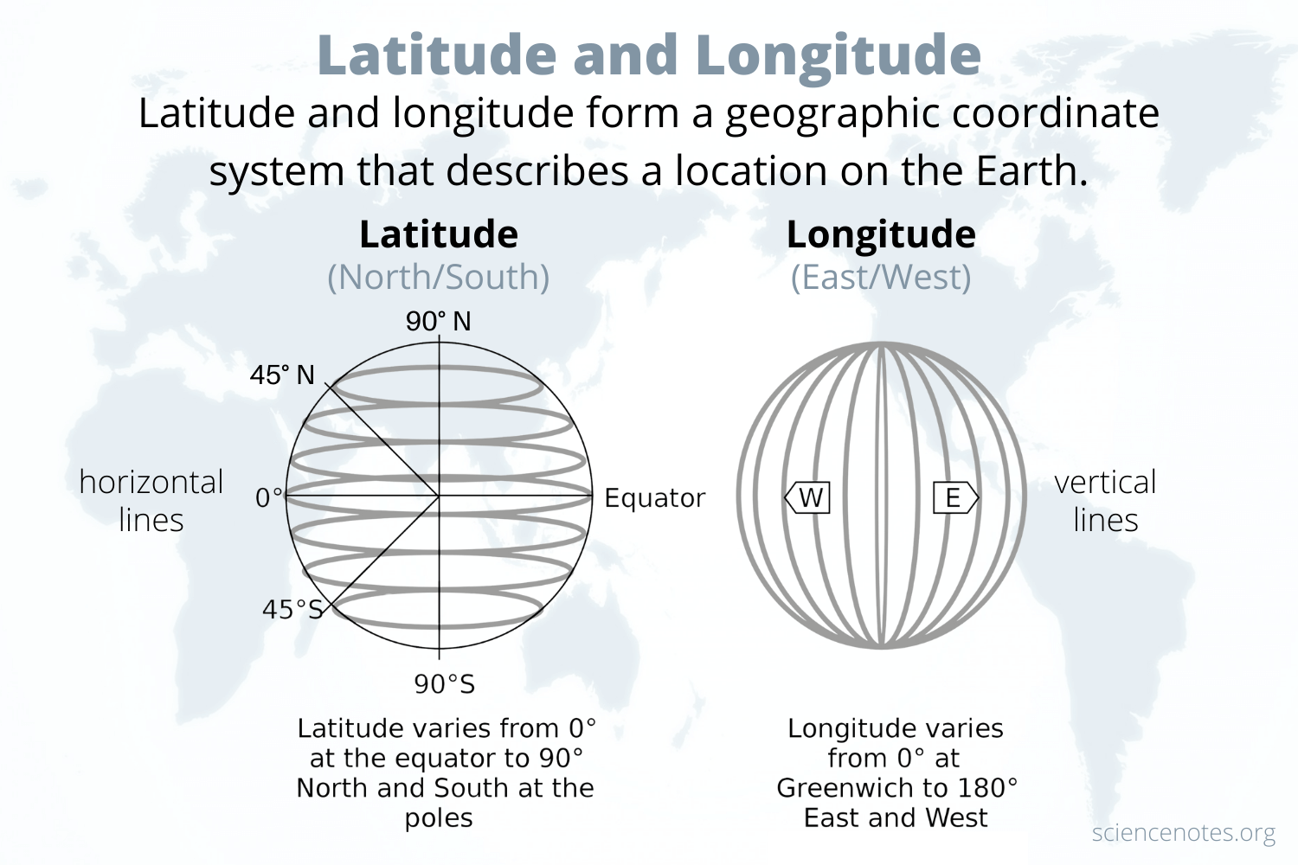
location!
Notes:
Wait, I’ve never seen you before. Are you an adjuct? A student? What?

Slide 18
names!
Notes:
Global Positioning Systems (GPS)
a system of earth-orbiting satellites which can provide precise (100 meter to sub-cm.) location on the earth’s surface (in lat/long coordinates or equiv.)
Remote Sensing (RS)
use of satellites or aircraft to capture information about the earth’s surface
Digital ortho images a key product (map accurate digital photos)
Geographic Information Systems (GISy)
Software systems with capability for input, storage, manipulation/analysis and output/display of geographic (spatial) information

Slide 19
gps
Notes:
Global Positioning Systems (GPS)
a system of earth-orbiting satellites which can provide precise (100 meter to sub-cm.) location on the earth’s surface (in lat/long coordinates or equiv.)
Remote Sensing (RS)
use of satellites or aircraft to capture information about the earth’s surface
Digital ortho images a key product (map accurate digital photos)
Geographic Information Systems (GISy)
Software systems with capability for input, storage, manipulation/analysis and output/display of geographic (spatial) information

Slide 20
data? from where?
Notes:
Global Positioning Systems (GPS)
a system of earth-orbiting satellites which can provide precise (100 meter to sub-cm.) location on the earth’s surface (in lat/long coordinates or equiv.)
Remote Sensing (RS)
use of satellites or aircraft to capture information about the earth’s surface
Digital ortho images a key product (map accurate digital photos)
Geographic Information Systems (GISy)
Software systems with capability for input, storage, manipulation/analysis and output/display of geographic (spatial) information

Slide 21
rs
Notes:
Global Positioning Systems (GPS)
a system of earth-orbiting satellites which can provide precise (100 meter to sub-cm.) location on the earth’s surface (in lat/long coordinates or equiv.)
Remote Sensing (RS)
use of satellites or aircraft to capture information about the earth’s surface
Digital ortho images a key product (map accurate digital photos)
Geographic Information Systems (GISy)
Software systems with capability for input, storage, manipulation/analysis and output/display of geographic (spatial) information

Slide 22
assemble!
Notes:
Global Positioning Systems (GPS)
a system of earth-orbiting satellites which can provide precise (100 meter to sub-cm.) location on the earth’s surface (in lat/long coordinates or equiv.)
Remote Sensing (RS)
use of satellites or aircraft to capture information about the earth’s surface
Digital ortho images a key product (map accurate digital photos)
Geographic Information Systems (GISy)
Software systems with capability for input, storage, manipulation/analysis and output/display of geographic (spatial) information

Slide 23
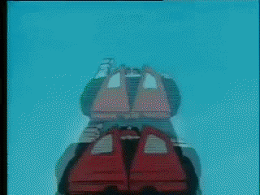
assemble!
Notes:
Systems
technology for the acquisition and management of spatial information
The focus of this course (GISC 6381 GIS Fundamentals)
Science
comprehending the underlying conceptual issues of representing data and processes in space-time
the theory and concepts behind the technology
Introduce enough of the science to apply the systems correctly and understand their capabilities and limitations
Studies
understanding the social, legal and ethical issues associated with the application of GISy and GISc

Slide 24
k.i.s.s.
Notes:
set of integrated tools for spatial analysis
encompasses end-to-end processing of data
capture, storage, retrieval, analysis/modification, display
uses explicit location on earth’s surface to relate data
aimed at decision support, as well as on-going operations and scientific inquiry

Slide 25
what is gis then?
Notes:
set of integrated tools for spatial analysis
encompasses end-to-end processing of data
capture, storage, retrieval, analysis/modification, display
uses explicit location on earth’s surface to relate data
aimed at decision support, as well as on-going operations and scientific inquiry

Slide 26
integrated tools
Notes:
set of integrated tools for spatial analysis
encompasses end-to-end processing of data
capture, storage, retrieval, analysis/modification, display
uses explicit location on earth’s surface to relate data
aimed at decision support, as well as on-going operations and scientific inquiry

Slide 27
end-to-end
Notes:
set of integrated tools for spatial analysis
encompasses end-to-end processing of data
capture, storage, retrieval, analysis/modification, display
uses explicit location on earth’s surface to relate data
aimed at decision support, as well as on-going operations and scientific inquiry

Slide 28
location as anchor
Notes:
set of integrated tools for spatial analysis
encompasses end-to-end processing of data
capture, storage, retrieval, analysis/modification, display
uses explicit location on earth’s surface to relate data
aimed at decision support, as well as on-going operations and scientific inquiry

Slide 29
decision-support
Notes:
set of integrated tools for spatial analysis
encompasses end-to-end processing of data
capture, storage, retrieval, analysis/modification, display
uses explicit location on earth’s surface to relate data
aimed at decision support, as well as on-going operations and scientific inquiry

Slide 30
but how?
Notes:
Layers!

Slide 31
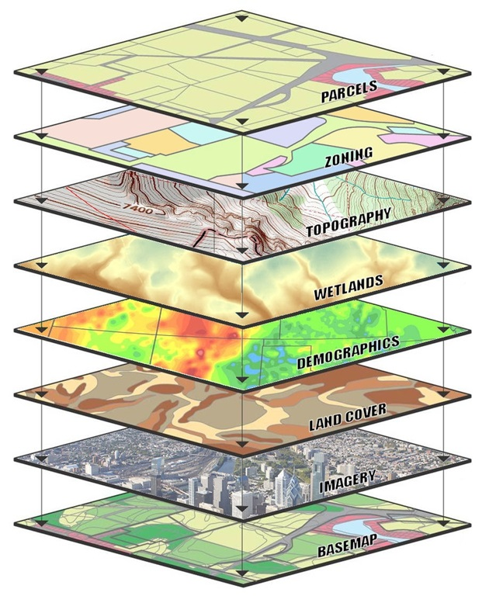
but how?
Notes:
Layers!

Slide 32
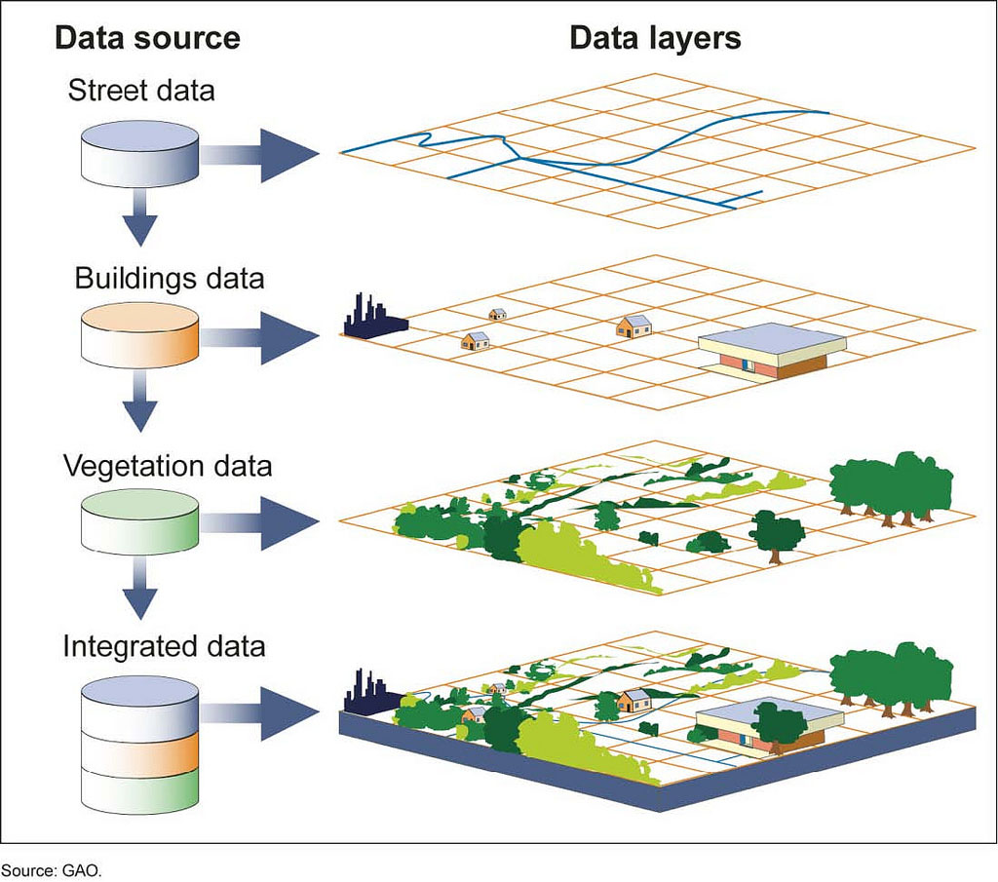
but how?
Notes:
Layers!

Slide 33
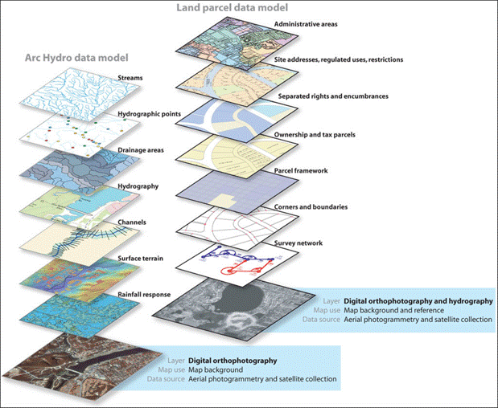
Notes:
Layers!

Slide 34
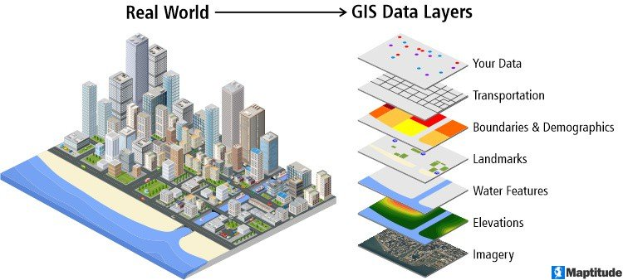
Notes:
Layers!

Slide 35
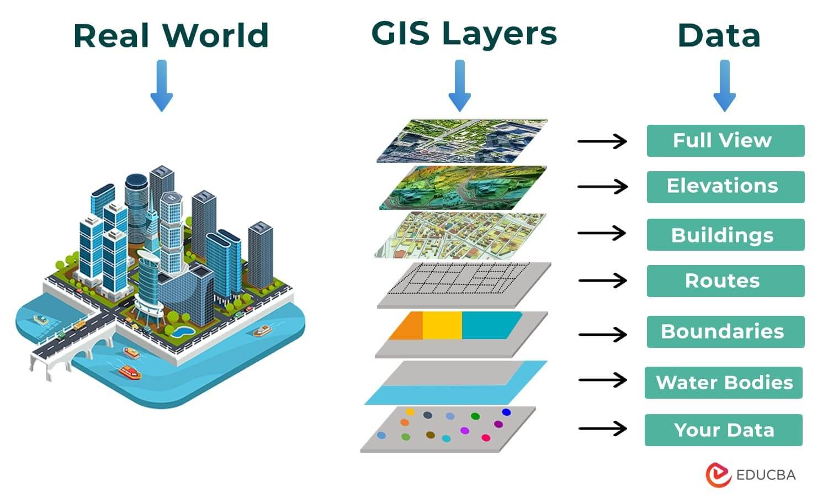
Notes:
Layers!

Slide 36
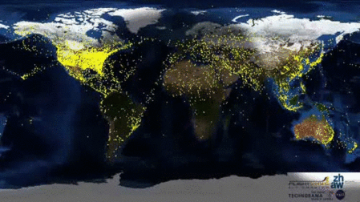
Notes:
Layers!

Slide 37
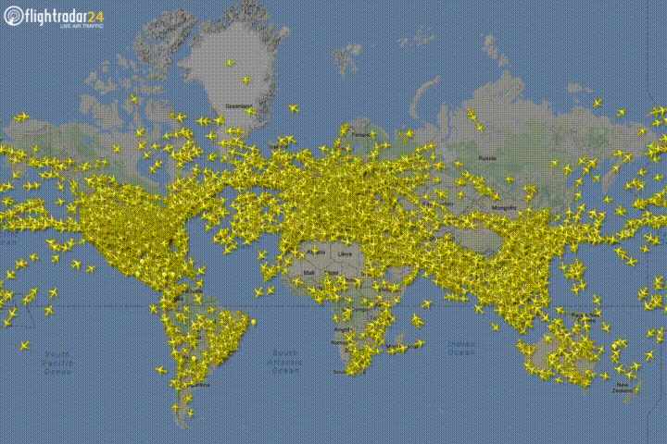
Notes:
Layers!

Slide 38
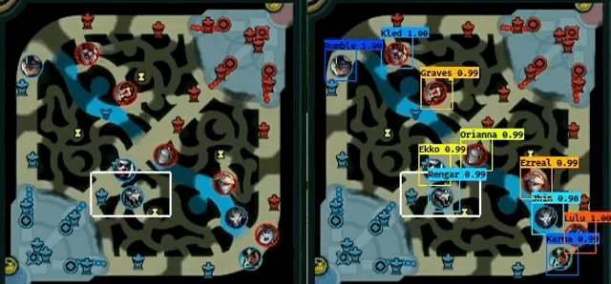
Notes:
Layers!

Slide 39
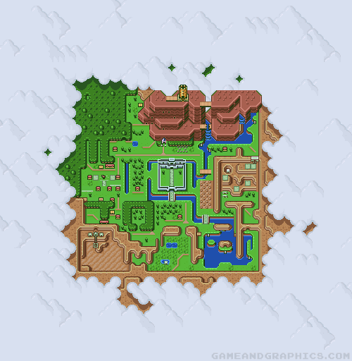
Notes:
Layers!

Slide 40
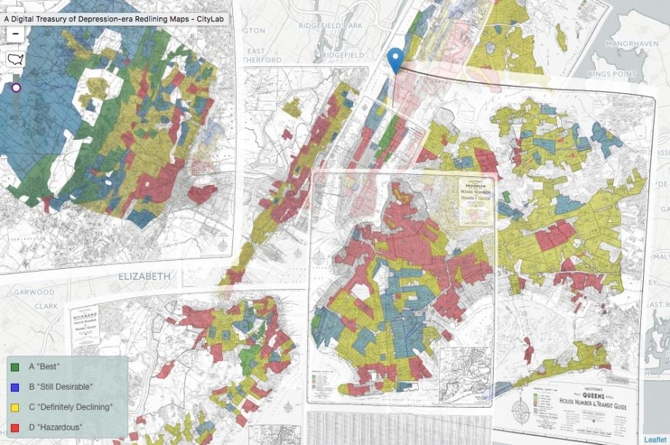
Notes:
Layers!

Slide 41
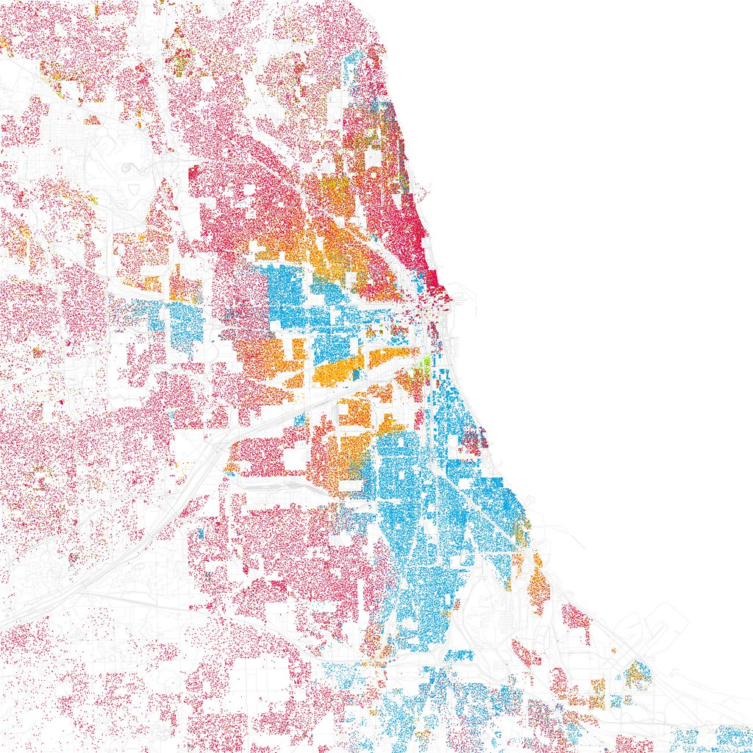
Notes:
Layers!

Slide 42
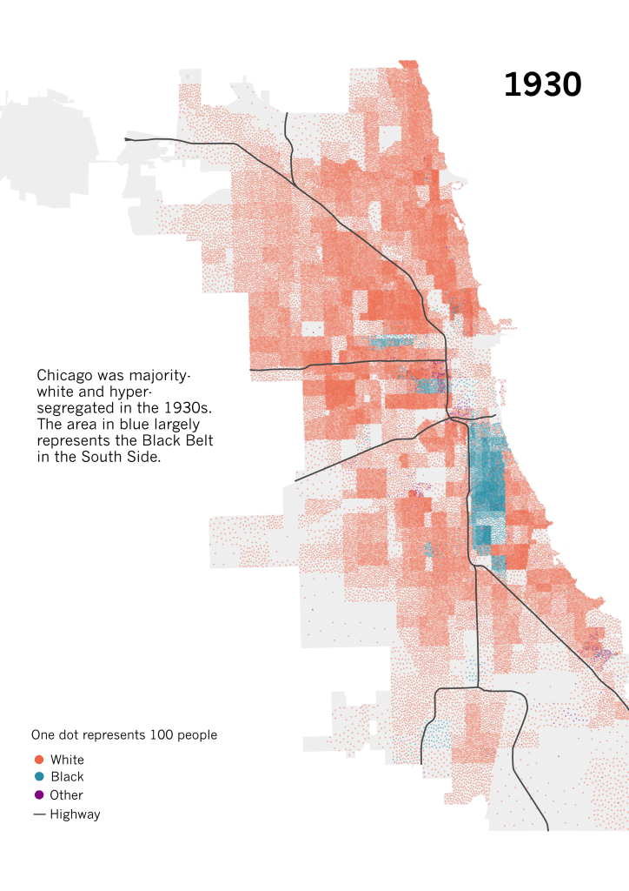
Notes:
Layers!

Slide 43
Sometimes all you need is 1 variable

Slide 44
qcc?

Slide 45
get out of here!

Slide 46
Nick LaLone njligm@rit.edu

